Slide 1
MHRN FEP Project Aims
Describe initial presentation
Examine patterns of care prior to diagnosis
Examine treatment adherence/continuity after diagnosis
Mine clinical text to identify possible prodromal “signals”
Explore provider, patient and family views regarding outreach interventions

Slide 2
Site of initial presentation
 | Initial Incidence (per 100k) | % Confirmed | Adjusted Incidence (per 100k) | Est. % of True Cases
Age 15-30, ER/Inpatient | 27 | 84% | 23 | 26%
Age 15-30, Outpatient MH | 56 | 78% | 44 | 51%
Age 15-30, Prim Care/Other | 42 | 47% | 20 | 23%
Age 15-30, TOTAL |  |  | 86 | 100%
Age 30-59, ER/Inpatient | 25 | 66% | 17 | 36%
Age 30-59, Outpatient MH | 37 | 57% | 21 | 46%
Age 30-59, Prim Care/Other | 45 | 19% | 9 | 19%
Age 15-30, TOTAL |  |  | 46 | 100%

Slide 3
Utilization prior to first diagnosis
 | MH IP Admit | MH ER Visit | MH OP Visit | PC w/ MH Dx | Any MH “Signal”
PRIOR 6 MOS
Psychosis | 10% | 19% | 27% | 27% | 41%
Depression | 4% | 10% | 31% | 28% | 43%
Inflamm Bowel Dis | 2% | 4% | 8% | 10% | 13%
PRIOR 24 MOS
Psychosis | 16% | 29% | 33% | 46% | 55%
Depression | 8% | 16% | 45% | 38% | 53%
Inflamm Bowel Dis | 8% | 9% | 17% | 23% | 29%

Slide 4
Utilization after first diagnosis (cumulative)
 | MH Spec Visit | PC Visit w/ MH Dx | Antipsych. Rx | Any MH Rx
WITHIN 3 MONTHS
Psychosis | 91% | 21% | 61% | 81%
Depression | 68% | 20% | 3% | 58%
General Population | 9% | 3% | <1% | 7%
WITHIN 12 MONTHS
Psychosis | 94% | 36% | 72% | 87%
Depression | 73% | 38% | 5% | 71%
General Population | 22% | 8% | <1% | 11%

Slide 5
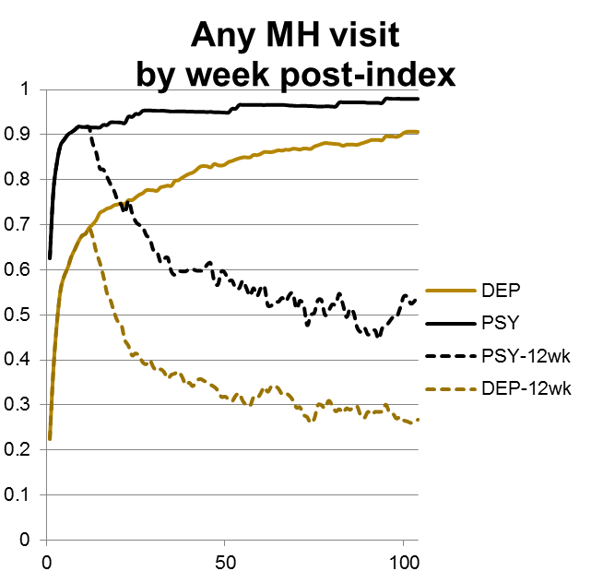
MH Specialty OP Utilization after 1st diagnosis

Slide 6
Utilization after first diagnosis (active)
 | MH Spec Visit | PC Visit w/ MH Dx | Antipsych. Rx | Any MH Rx
AT 6 MONTHS
Psychosis | 75% | 13% | 47% | 65%
Depression | 47% | 13% | 4% | 48%
AT 18 MONTHS
Psychosis | 53% | 7% | 31% | 55%
Depression | 30% | 8% | 2% | 33%

Slide 7
Chart reviews for “lost to follow-up”
 | N=147 | %
Documented resolution | 23 | 16%
Psychosis at last contact | 52 | 35%
Other MH symptoms at last contact | 43 | 29%
Visits with no mention | 29 | 20%

Slide 8
NLP for detection of signals before diagnosis
Used “corpus” of text harvested by chart reviewers during Aim 1 chart reviews
Search for matches during year prior to diagnosis
Compare to matches in depression diagnosis comparison group

Slide 9
Paper plan
Aim 1: Incidence and site of presentation (Greg)- accepted by Psych Services
Aim 2a: Utilization prior to diagnosis (Rob) – drafting
Aim 2b: Race/ethnicity differences in utilization prior to diagnosis (Karen) – analyses complete
Aim 3: Utilization after diagnosis (Bobbi Jo) – drafting
Aim 4: Source of insurance at and after diagnosis (Frances) – analyses pending

Slide 10
Where are the gaps?
Detection
  Incidence rate suggests reasonable capture of all new cases
  Half have some prior mental health contact
  BUT – significant differences by race/ethnicity
Initiation
  >90% with outpatient specialty MH follow-up within 1 month
  >60% with filled prescription for antipsychotic medication within 1 month
Engagement / Continuation
  Only 50% still engaged in outpatient specialty MH care by 1 year
  Of those who disengage: outcome is poor in 1/3 and unknown in 1/3
Familiar story: It’s not a bottleneck, it’s a sieve.

